Slide 1

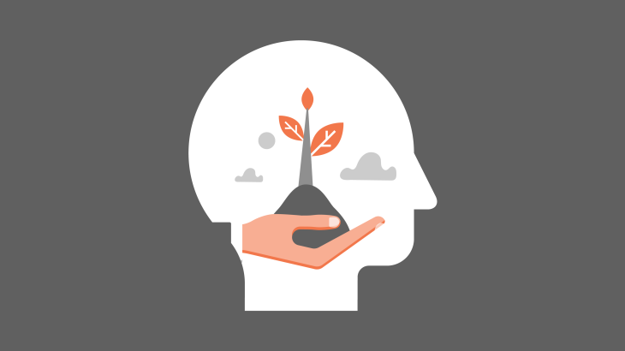
MENTAL HEALTH
BY:
Syed Muhammad Hassan Ali.
20k-1052

Slide 2
Introduction
Mental health includes our emotional, psychological, and social well-being.
It affects how we think, feel, and act. It also helps determine how we handle stress, relate to others, and make choices.
Mental health is important at every stage of life, from childhood and adolescence through adulthood.
A person can experience poor mental health and not be diagnosed with a mental illness.

Slide 3
Causes of Mental Illness
Depression is one of the leading causes of mental disorder.
Early adverse life experiences, such as trauma or a history of abuse (for example, child abuse, sexual assault, witnessing violence, etc.)
Experiences related to other ongoing (chronic) mental conditions, such as cancer or diabetes.
Use of alcohol or recreational drugs
Having feeling of loneliness or isolation

Slide 4
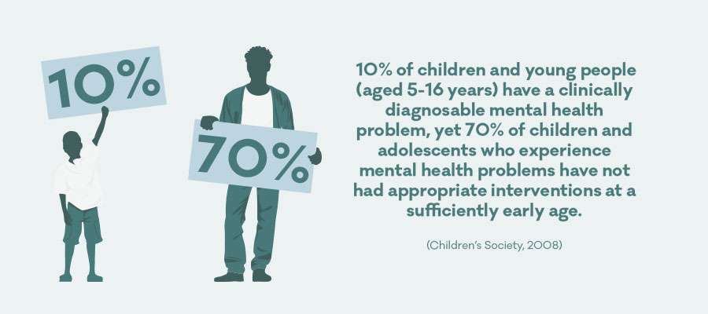
How common are mental illnesses?
More than 50% will be diagnosed with a mental illness or disorder at some point in their lifetime.
1 in 5 Americans will experience a mental illness in a given year.
1 in 5 children, either currently or at some point during their life, have had a seriously debilitating mental illness.
1 in 25 Americans lives with a serious mental illness, such as schizophrenia, bipolar disorder, or major depression.

Slide 5
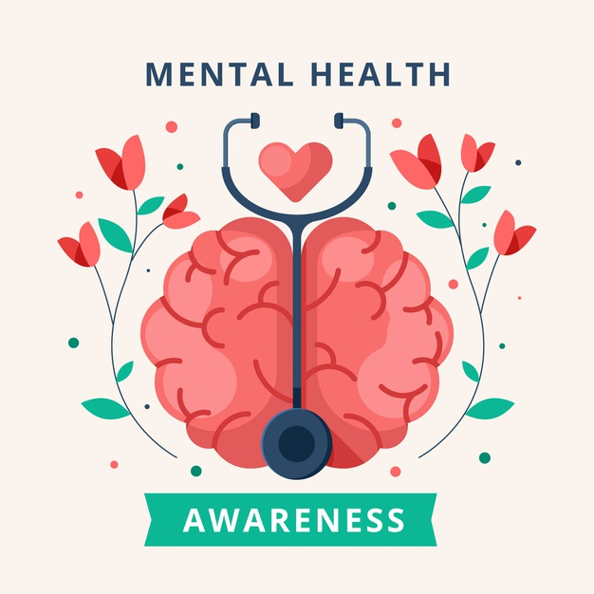
Mental Health awarness
The overall number of people reporting mental health problems has been going up in recent years
Suicidal thoughts and self-harm aren’t mental health diagnoses. But they are related to mental health.
Yes, it’s important to remember that a
person’s mental health can change over time.

Slide 6
How to improve mental health?
Trying to hold on to the positive emotions when you have them
Taking a break from negative information. Know when to stop watching or reading the news. Use social media to reach out for support and feel connected to others but be careful. Don't fall for rumors, get into arguments, or negatively compare your life to others.
Sleep affects your mood. If you don't get a good sleep, you may become more easily annoyed and angry. Over the long term, a lack of quality sleep can make you more likely to become depressed. So it's important to make sure that you have a regular sleep schedule and get enough quality sleep every night.
Humans are social creatures, and it's important to have strong, healthy relationships with others. Having good social support may help protect you against the harms of stress. It is also good to have different types of connections. Besides connecting with family and friends, you could find ways to get involved with your community or neighborhood. For example, you could volunteer for a local organization or join a group that is focused on a hobby you enjoy.

Slide 7
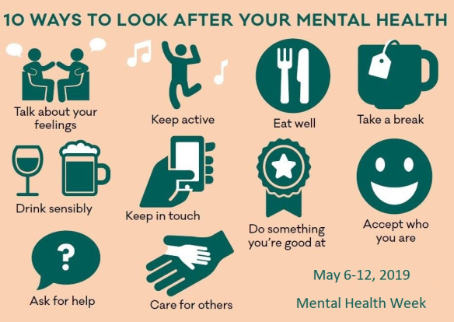
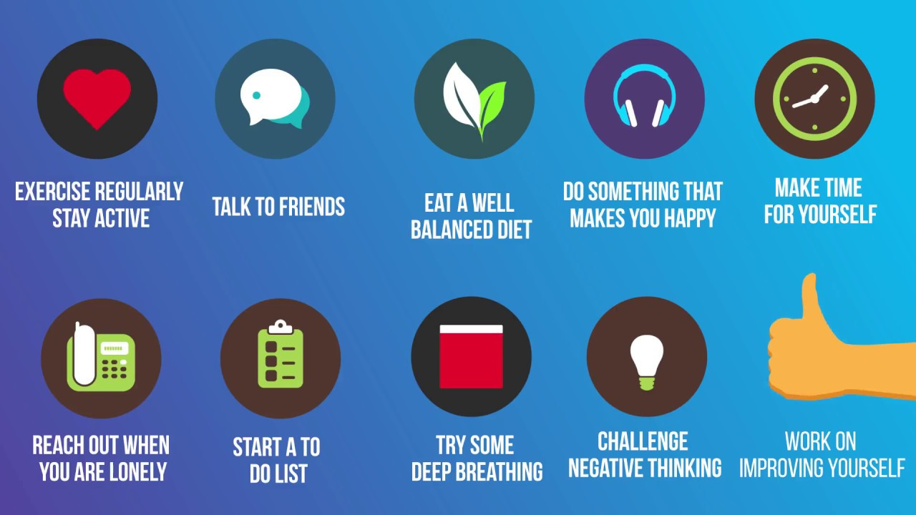

Slide 8

Mental health day
This year’s World Mental Health Day, on 10 October, comes at a time when our daily lives have changed considerably as a result of the COVID-19 pandemic. The past months have brought many challenges: for health-care workers, providing care in difficult circumstances, going to work fearful of bringing COVID-19 home with them; for students, adapting to taking classes from home, with little contact with teachers and friends, and anxious about their futures; for workers whose livelihoods are threatened; for the vast number of people caught in poverty or in fragile humanitarian settings with extremely limited protection from COVID-19.

Slide 9
Thank you

